Slide 1
Buffer Overflow

Slide 2
Outline
Buffer Overflow
Suggested reading
Chap 3.10.4

Slide 3
Out-of-Bounds Memory References
1 /* Implementation of library function gets() */
2 char *gets(char *s)
3 {
4 int c;
5 char *dest = s;
6
7 while ((c = getchar()) != ’\n’ && c != EOF)
8 *dest++ = c; /* No bounds checking */
9 if (c == EOF && dest ==s)
10 return NULL; /* No characters read */
11 *dest++ = ’\0’; /* Terminate String */
12 return s;
13 }

Slide 4
Out-of-Bounds Memory References
14 /* Read input line and write it back */
15 void echo()
16 {
17 char buf[8]; /* Way too small ! */
18 gets(buf);
19 puts(buf);
20 }

Slide 5
Out-of-Bounds Memory References
Return address
[7] | [6] | [5] | [4]
[3] | [2] | [1] | [0]
Stack frame
for caller
Stack frame
for echo
buf

Slide 6
Out-of-Bounds Memory References
Return address
[11] | [10] | [9] | [8]
[7] | [6] | [5] | [4]
[3] | [2] | [1] | [0]
Stack frame
for caller
Stack frame
for echo
buf

Slide 7
Out-of-Bounds Memory References
Return address
[15] | 1[4] | [13] | [12]
[11] | [10] | [9] | [8]
[7] | [6] | [5] | [4]
[3] | [2] | [1] | [0]
Stack frame
for caller
Stack frame
for echo
buf

Slide 8
Out-of-Bounds Memory References
[23] | [22] | [21] | [20]
[19] | [18] | [17] | [16]
[15] | 1[4] | [13] | [12]
[11] | [10] | [9] | [8]
[7] | [6] | [5] | [4]
[3] | [2] | [1] | [0]
Stack frame
for caller
Stack frame
for echo
buf

Slide 9
Malicious Use of Buffer Overflow
Stack
after call to gets()
void foo(){
bar();
...
}
return
address
A
foo stack frame
void bar() {
char buf[64];
gets(buf);
...
}
B
data
written
by
gets()
pad
exploit
code
bar stack frame
B

Slide 10
The Famous Internet Worm of November 1988
To gain access to many of the computers across the Internet
4 different ways
One was a buffer overflow attack on the fingerd
Hundreds of machines were effectively paralyzed
The author of the worm was caught and prosecuted. He was sentenced to
3 years probation
400 hours of community service
and a $10,500 fine

Slide 11
The Famous Internet Worm of November 1988
Steps
invoked finger with an appropriate string
Made a process at a remote site have a buffer overflow
executed code that gave the worm access to the remote system
The worm replicated itself and consumed virtually all of the machine’s computing resources

Slide 12

Morris Worm
Robert Tappan Morris
born November 8, 1965
a professor at MIT
He is the son of Robert Morris
the former chief scientist at the National Computer Security Center
a division of the National Security Agency (NSA)

Slide 13
Stack Randomization
1 int main() {
2 long local;
3 printf("local at %p\n", &local);
4 return 0;
5 }
Running the code 10,000 times on a Linux (maybe 2.6.16) machine in 32-bit mode
the addresses ranged from
0xff7fc59c to 0xffffd09c
A range of around 2²³

Slide 14
Stack Randomization
Running in 64-bit mode on the newer machine
The addresses ranged from
0x7fff0001b698 to 0x7ffffffaa4a8
A range of nearly 2³²
Address-space layout randomization (ASLR)
each time a program is run
different parts of the program are loaded into different regions of memory
code, data, heap data, library code, stack

Slide 15
Stack Randomization
Nop sled
a program “slides” through a long sequence of “nop”
Nop
no operation instruction
Include a “nop sled” before the actual exploit code
If insert 256-byte nop sled
Need to guess 2¹⁵ starting addresses (no too much) for 32-bit machine
Still have too many 2²⁴ for 64-bit machine

Slide 16
Stack Corruption Detection
Return address
Canary
[7] | [6] | [5] | [4] | [3] | [2] | [1] | [0]
Stack frame
for caller
%rsp+24
Stack frame
for echo
buf=%rsp

Slide 17
Stack Corruption Detection
1 echo:
2 subq $24, %rsp # Allocate 24 bytes on stack
3 movq %fs:40, %rax # Retrieve canary
4 movq %rax, 8(%rsp) # Store on stack
5 xorl %eax, %eax # Zero out register
6 movq %rsp, %rdi # Compute buf as %rsp
7 call gets # Call gets
8 movq %rsp, %rdi # Compute buf as %rsp
9 call puts # Call puts
10 movq 8(%rsp), %rax # Retrieve canary
11 xorq %fs:40, %rax # Compare to stored value
12 je .L9 # If =, goto ok
13 call __stack_chk_fail # Stack corrupted!
14 .L9 # ok:
15 addq $24, %rsp # Deallocate stack space
16 ret

Slide 18
Stack Corruption Detection
%fs:40
Segmented addressing which appeared in 80286 and seldom used today
It is marked as read only

Slide 19
Limiting Executable Code Regions
Page
4k bytes
As a protected unit by OS
Should be marked as “readable”, “writable” and “executable”
3 bits are required
Originally Intel merged the “readable” and “executable” into one
The exploit code in the stack can be executed
AMD introduced “NX” in X86-64
Now there 3 bits
How about “JIT”?

Slide 20
Code Reuse Attack
Return-oriented Programming
Find code gadgets in existed code base (e.g. libc)
Push address of gadgets on the stack
Leverage ‘ret’ to connect code gadgets
No code injection
Solutions
Return-less kernels
Heuristic means
Address C
Address B
Address A
return addr
A
0101011010
每个gadget应该包含一条指令和
一个相邻的ret指令（一般是从
一条完整指令中进行截取）
B
0101011010
C
0101011010

Slide 21
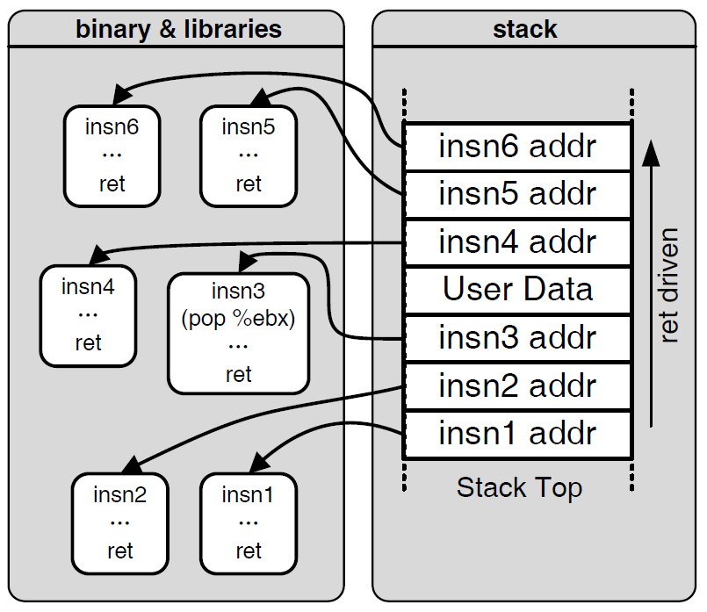

Motivation: Code Reuse Attack

Slide 22
Understanding Pointers

Slide 23
Outline
Understanding Pointers
Suggested reading
Chap 3.10.1

Slide 24
Pointers
Every pointer has a type
If the object has type T
A pointer to this object has type T *
Special void * type(没有具体类型的pointer)
Represents a generic pointer
malloc(分配内存的函数) returns a generic pointer
Every pointer has a value

Slide 25
Pointers
Pointers are created with the & operator
Applied to lvalue expression
Lvalue expression can appear on the left side of assignment
Pointers are dereferenced with the operator *
The result is a value having the type associated with the pointer
Arrays and pointers are closed related
The name of array can be viewed as a pointer constant
ip[0] is equivalent to *ip

Slide 26
Pointer Arithmetic
Addition and subtraction
p+i , p-i (result is a pointer)
p-q (result is a long)
Referencing & dereferencing
*p, &E
Subscription
A[i], *(A+i)

Slide 27
Example
static int daytab[2][13] = {
{0, 31, 28, 31, 30, 31, 30, 31, 31, 30, 31, 30, 31},
{0, 31, 29, 31, 30, 31, 30, 31, 31, 30, 31, 30, 31}
}
/* day_of_year: set day of year from month & day */
int day_of_year(int year, int month, int day)
{
int i, leap;
leap = (year%4 == 0 && year%100 != 0 || year%400 ==0);
for (i = 1; i < month; i++)
day += daytab[leap][i];
return day;
}

Slide 28
Example
/* month_day: set month, day from day of year */
int month_day(int year, int yearday, int *pmonth, int *pday)
{
int i, leap;
leap = (year%4 == 0 && year%100 != 0 || year%400 ==0);
for (i = 1; yearday > daytab[leap][i] ; i++)
yearday -= daytab[leap][i];
*pmonth = i;
*pday = yearday;
}

Slide 29
Pointer Array
/* month_name: return name of n-th month */
char *month_name(int n)
{
static char *name[] = {
“Illegal month”,
“January”, “February”, “March”,
“April”, “May”, “June”,
“July”, “August”, “September”,
“October”, “November”, “December”
};
return (n < 1 || n > 12) ? name[0] : name[n];
}
单目运算符默认右结合

Slide 30
Pointer Array
Illegal month\0
January\0
February\0
March\0
April\0
May\0
June\0
July\0
August\0
September\0
October\0
November\0
December\0

Slide 31
Command-line Arguments
argv:
$echo hello, world
$hello, world
#include <stdio.h>
/* echo command-line arguments */
int main(int argc, char *argv[])
{
int i ;
for (i = 1; i < argc ; i++)
printf(“%s%s”, argv[i], (i < argc-1) ? “ ” : “”);
printf(“\n”) ;
return 0;
}
NULL
echo\0
Hello,\0
World\0

Slide 32
Command-line Arguments
#include <stdio.h>
/* echo command-line arguments ; 2nd version*/
int main(int argc, char *argv[])
{
while (--argc > 0)
printf(“%s%s”, ++argv, (argc > 1) ? “ ” : “”);
printf(“\n”);
return 0;
}
or
printf((argc > 1) ? “%s ” : “%s”, ++argv);

Slide 33
Pointer to Function
#include <stdlib.h>
/* numcmp: compare s1 and s2 numerically */
int numcmp(char *s1, char *s2)
{
double v1, v2;
v1 = atof(s1);
v2 = atof(s2);
if (v1 < v2) return -1;
else if ( v1 > v2 ) return 1;
else return 0;
}

Slide 34
Pointer to Function
#include <stdio.h>
#include <string.h>
{
...
int numeric = 0, (*cmp)(void *, void *);
char *s1, *s2;
...
if (...) numeric = 1 ;
...
cmp = (int (*)(void *, void *)) (numeric ? numcmp : strcmp);
(*cmp)(s1, s2);
...
}

Slide 35
Pointers can point to functions
void (*f)(int *)
f is a pointer to function
The function taken int * as argument
The return type of the function is void
Assignment makes f point to func
f = func
Notice the precedence of the operators
void *f(int *) declares f is a function
(void *) f(int *)

Slide 36
Pointer Declaration
char **argv ;
int (*daytab)[13]
int (*comp)()
char (*(*x())[])()
Function returning pointer to array[ ] of pointer to function returning char
char (*(*x[3])())[5]
Array[3] of pointer to function returning pointer to array[5] of char

Slide 37
C operators
Operators Associativity
() [] -> . ++ -- left to right
! ~ ++ -- + - * & (type) sizeof right to left
* / % left to right
+ - left to right
<< >> left to right
< <= > >= left to right
== != left to right
& left to right
^ left to right
| left to right
&& left to right
|| left to right
?: right to left
= += -= *= /= %= &= ^= != <<= >>= right to left
, left to right
Note: Unary(一元的) +, -, and * have higher precedence than binary forms

Slide 38
Parameter Passing
Call by value
f(xp)
Call by reference
f(&xp)

Slide 39
Supporting Variable-Size Stack Frames
(a) C code
long vframe(long n, long idx, long *q) {
long i;
long *p[n];
p[0] = &i;
for (i = 1; i < n; i++)
p[i] = q;
return *p[idx];
}

Slide 40
Supporting Variable-Size Stack Frames
(b) Portions of generated assembly code
long vframe(long n, long idx, long *q)
n in %rdi, idx in %rsi, q in %rdx
Only portions of code shown
1 vframe:
2 pushq %rbp Save old %rbp
3 movq %rsp, %rbp Set frame pointer

Slide 41
Supporting Variable-Size Stack Frames
4 subq $16, %rsp Allocate space for i (%rsp = s1)
5 leaq 22(,%rdi,8), %rax
6 andq $-16, %rax
7 subq %rax, %rsp Allocate space for array p (%rsp = s2)
8 leaq 7(%rsp), %rax
9 shrq $3, %rax
10 leaq 0(,%rax,8), %r8 Set %r8 to &p[0]
11 movq %r8, %rcx Set %rcx to &p[0] (%rcx = p)
. . .
Code for initialization loop
i in %rax and on stack, n in %rdi, p in %rcx, q in %rdx

Slide 42
Supporting Variable-Size Stack Frames
12 .L3: loop:
13 movq %rdx, (%rcx,%rax,8) Set p[i] to q
14 addq $1, %rax Increment i
15 movq %rax, -8(%rbp) Store on stack
16 .L2:
17 movq -8(%rbp), %rax Retrieve i from stack
18 cmpq %rdi, %rax Compare i:n
19 jl .L3 If <, goto loop
. . .
Code for function exit
20 leave Restore %rbp and %rsp
21 ret Return

Slide 43
Supporting Variable-Size Stack Frames
Using %rbp as a frame pointer for the top of the stack frame
At the beginning of vframe
pushq %rbp
movq %rsp, %rbp
At the end of vframe
movq %rbp, %rsp
popq %rbp

Slide 44
Supporting Variable-Size Stack Frames

Slide 45
Supporting Variable-Size Stack Frames
The leaq instruction of line 5
computes the value 8n + 22
which is then rounded down to the nearest multiple of 16
by the andq instruction of line 6.
The resulting value will be
8n + 8 when n is odd
8n + 16 when n is even
This value is subtracted from s1 to give s2

Slide 46
Supporting Variable-Size Stack Frames
The three instructions in lines 8-10 round s2 up to the nearest multiple of 8.
They make use of the combination of biasing and shifting
(S2+7)/8
n | s1 | s2 | p | e1 | e2
5 | 2065 | 2017 | 2024 | 1 | 7
6 | 2064 | 2000 | 2000 | 16 | 0

Slide 47
Supporting Variable-Size Stack Frames
s2 is computed in a way that preserves whatever offset s1 has with the nearest multiple of 16
p will be aligned on a multiple of 8
as is recommended for an array of 8-byte elements

